Slide 1
11 INTRODUCING CSS

Slide 2
Document Structure
Documents have an implicit structure.
We give certain relationships names, as if they’re a family:
All the elements contained in a given element are its descendents.
An element that is directly contained within another element is the child of that element.
The containing element is the parent of the contained element.
Two elements with the same parent are siblings.

Slide 3
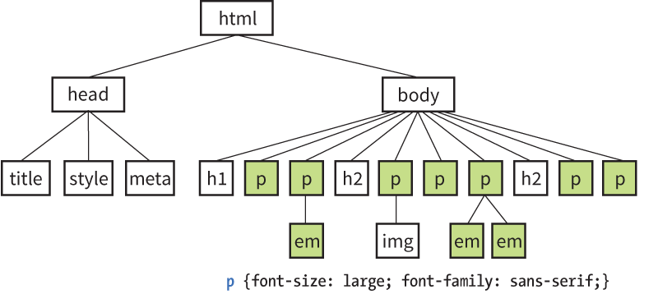
Inheritance
Many properties applied to elements are passed down to the elements they contain. This is called inheritance.
For example, applying a sans-serif font to a p element causes the em element it contains to be sans-serif as well:

Slide 4
Inheritance (cont’d)
Some properties inherit; others do not. Properties related to text usually inherit; properties related to layout generally don’t.
Styles explicitly applied to specific elements override inherited styles.
You’ll learn to use inheritance strategically to keep your style rules simple.

Slide 5
The Cascade
The cascade refers to the system for resolving conflicts when several styles apply to the same element.
Style information is passed down (it “cascades” down) until overwritten by a style rule with more weight.
Weight is considered based on:
Priority of style rule source (e.g., user rules, developer rules, browser rules)
Specificity of the selector (e.g., inline rule more specific than external, id more specific than just an element etc.)
Rule order

Slide 6
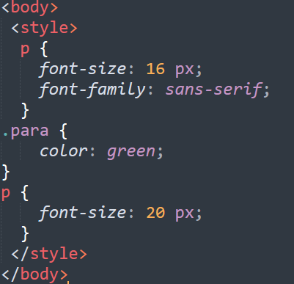
The Cascade
For example
Here p is an element selector and .par is a class selector

Slide 7
The Cascade: Rule Order
When two rules have equal weight, rule order is used. Whichever rule appears last “wins.”
<style>
p {color: red;}
p {color: blue;}
p {color: green;}
</style>
In this example, paragraphs would be green.
Styles may come in from external style sheets, embedded style rules, and inline styles. The style rule that gets parsed last (the one closest to the content) will apply.

Slide 8

Specifity
A class selector is most specific than element selector
The id selector is more specific than class selector

Slide 9
CSS Units of Measurement
CSS has several units for expressing a length
Many CSS properties take “length” values such as width, margin, padding, font-size, etc
Length is a number followed by length unit, such as 10 px, 2em, etc
There are two types of length units such as Absolute lengths, Relative lengths.

Slide 10
CSS Units of Measurement
CSS provides a variety ways to specify measurements:
Absolute units
Have predefined meanings or real-world equivalents
Relative units
Based on the size of something else, such as the default text size or the size of the parent element
Percentages – recommended for course work
Calculated relative to another value, such as the size of the parent element

Slide 11
Absolute Units
With the exception of pixels, absolute units are not appropriate for web design:
px pixel
em em is a unit of measurement which indicates size relative to the size of the font. 1em means "equal to the current font size", and 2em means 2 times the current font size.
in inches
mm millimeters
cm centimeters
q 1/4 millimeter
pt points (1/72 inch)
pc pica (1 pica = 12 points = 1/6 inch)

Slide 12
Relative Units
Relative units are based on the size of something else:
em a unit equal to the current font size
ex x-height, equal to the height of a lowercase x
rem root element, equal to the font size of the html element
ch zero width, equal to the width of a zero (0)
vw viewport width unit (equal to 1/100 of viewport width)
vh viewport height unit (1/100 of viewport height)
vmin viewport minimum unit (value of vh or vw, whichever is smaller)
vmax viewport maximum unit (value of vh or vw, whichever is larger)

Slide 13
RELATIVE UNITS
Viewport Percentage Lengths (vw/vh)
Viewport width (vw) and viewport height (vh) units are relative to the size of the viewport (browser window):
vh = 1/100th width of viewport
vh = 1/100th height of viewport
They’re useful for making an element fill the viewport or a specified percentage of it. This image will be 50% the width and height of the viewport:
img { width: 50vw; height: 50vh; }

Slide 14
End of Lecture

